Slide 1
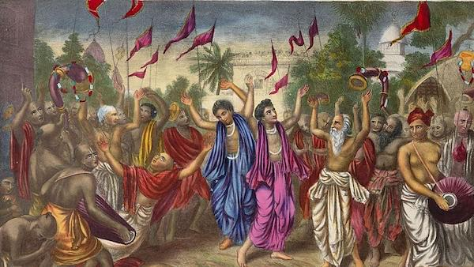
BHAKTI MOVEMENT
Non B.tech 2nd year ESP-III

Slide 2
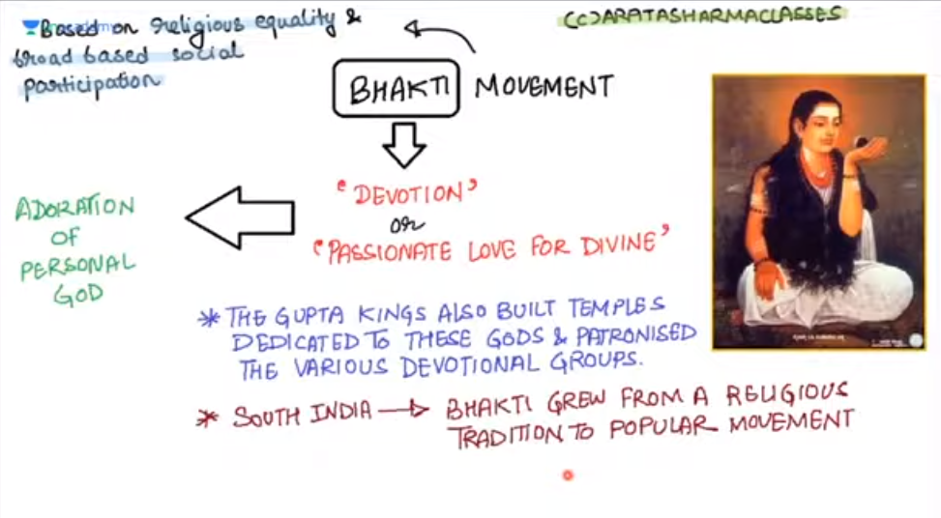

Slide 3
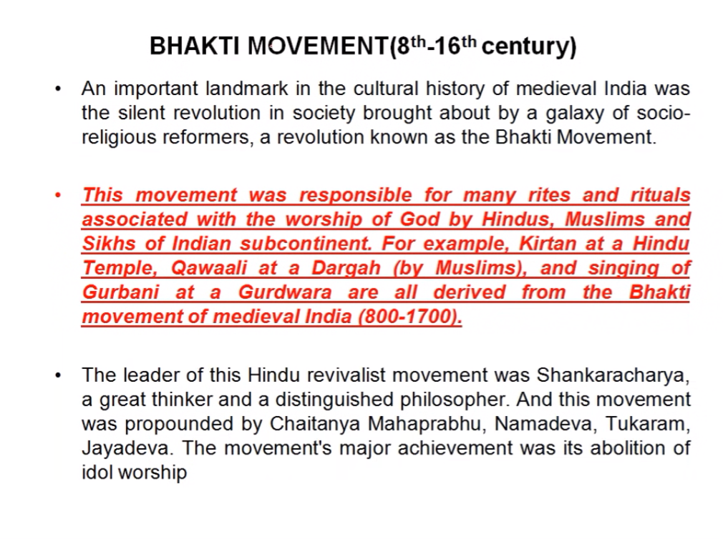

Slide 4
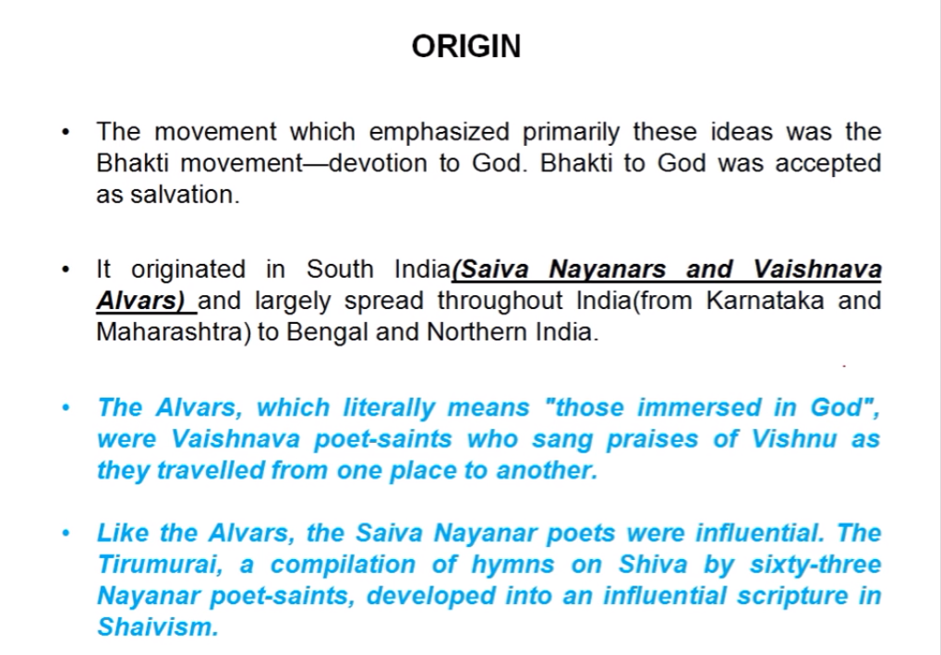

Slide 5
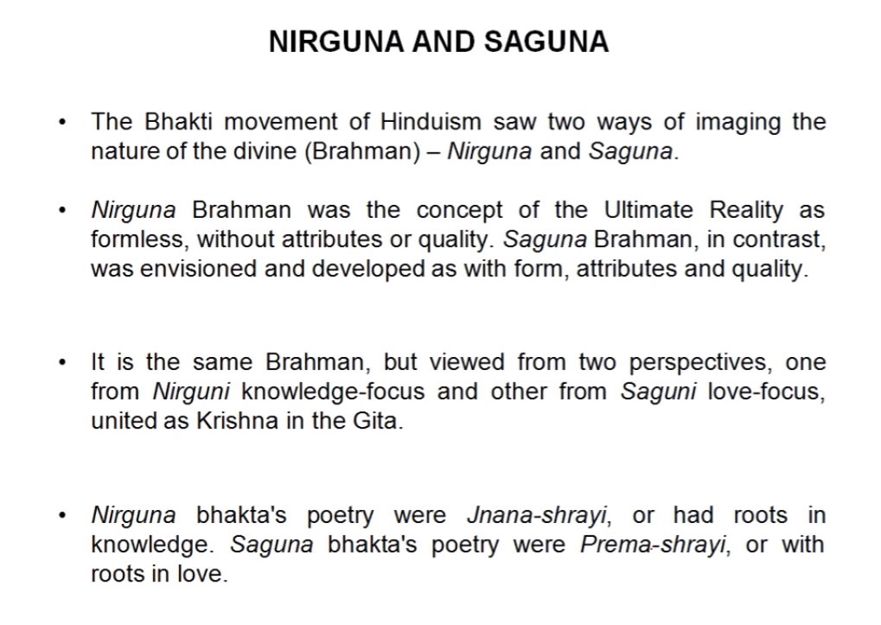

Slide 6
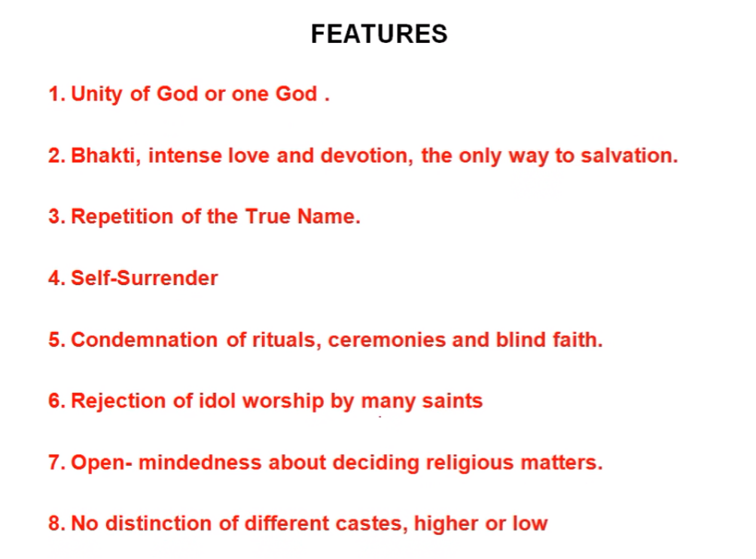

Slide 7
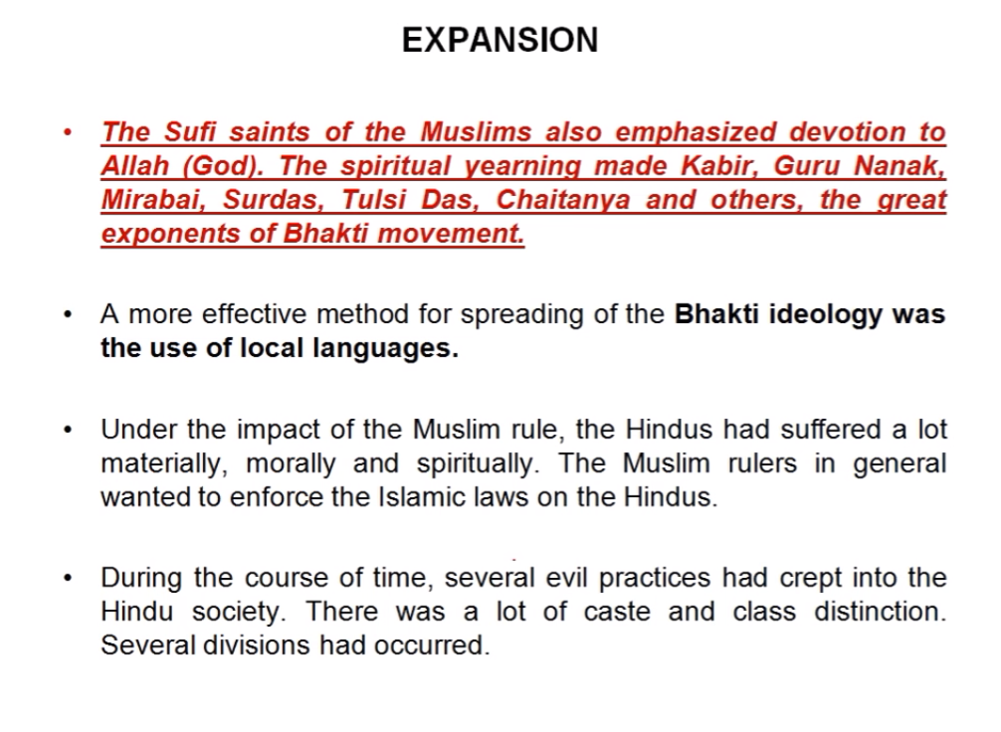

Slide 8
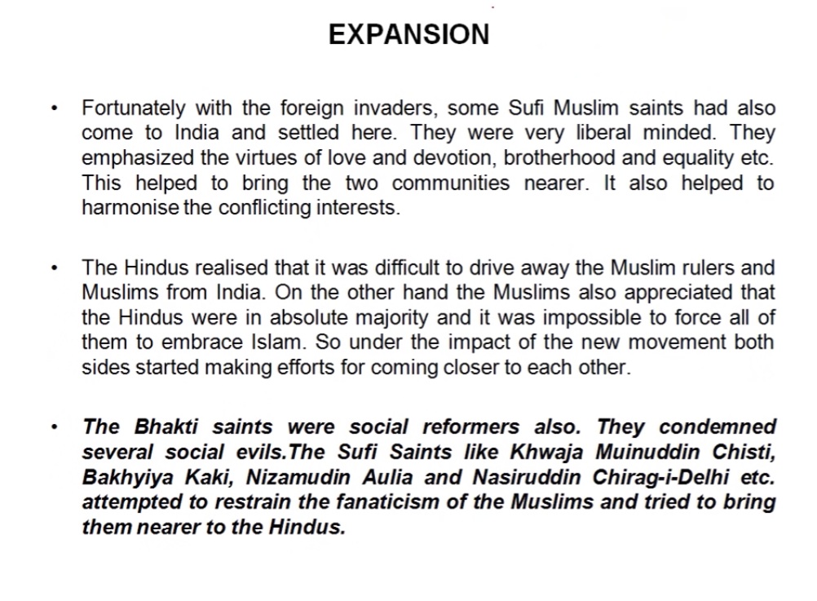

Slide 9
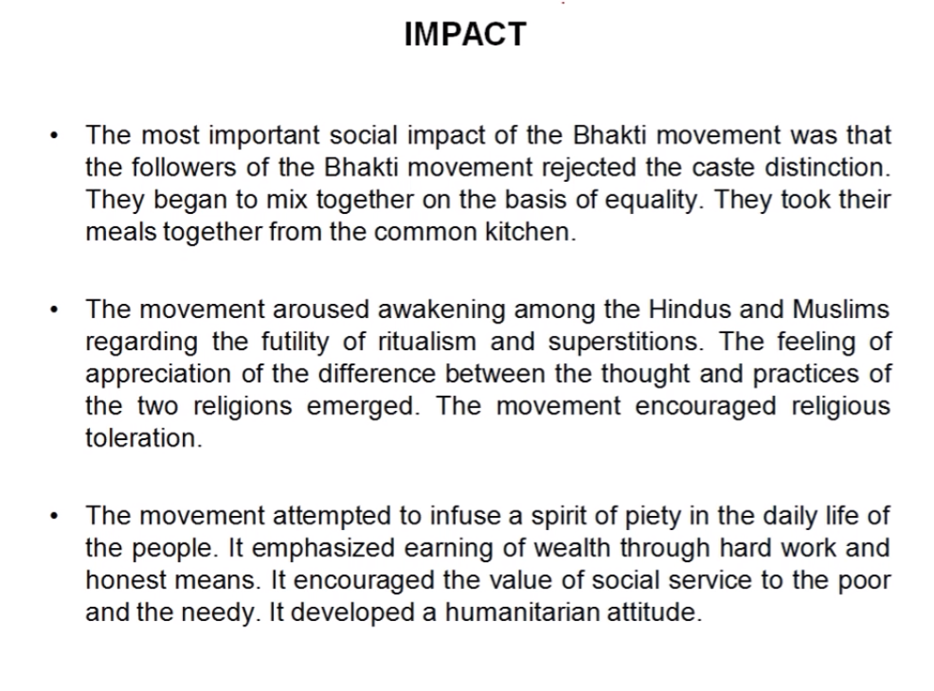

Slide 10
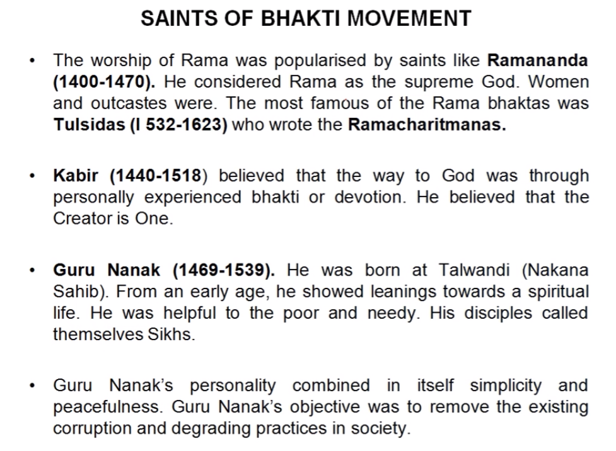

Slide 11
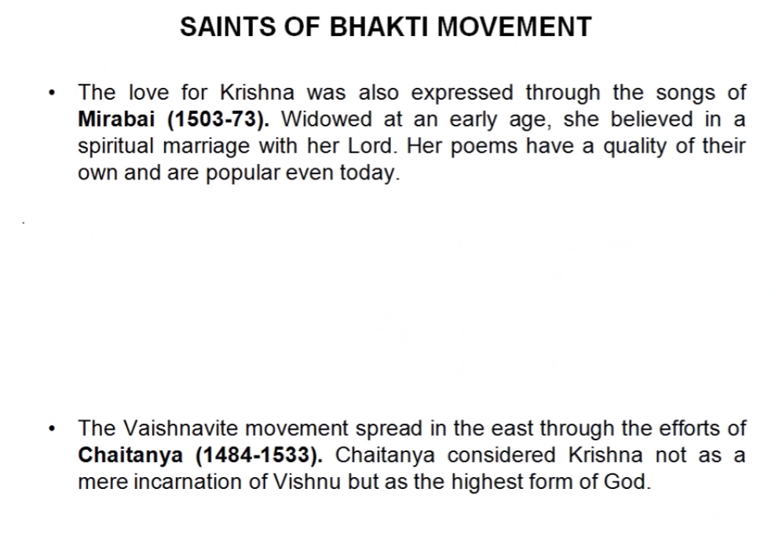

Slide 12
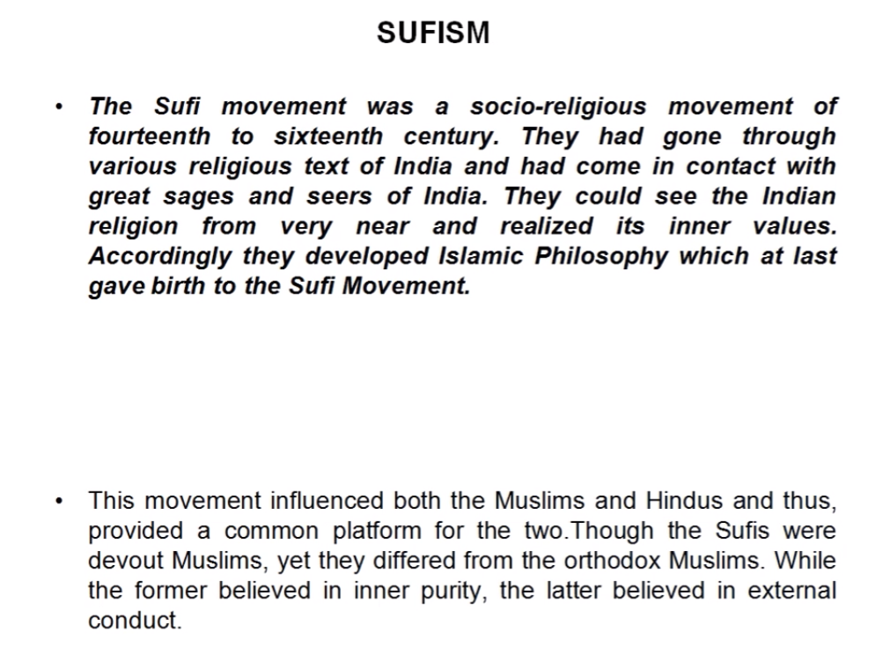

Slide 13
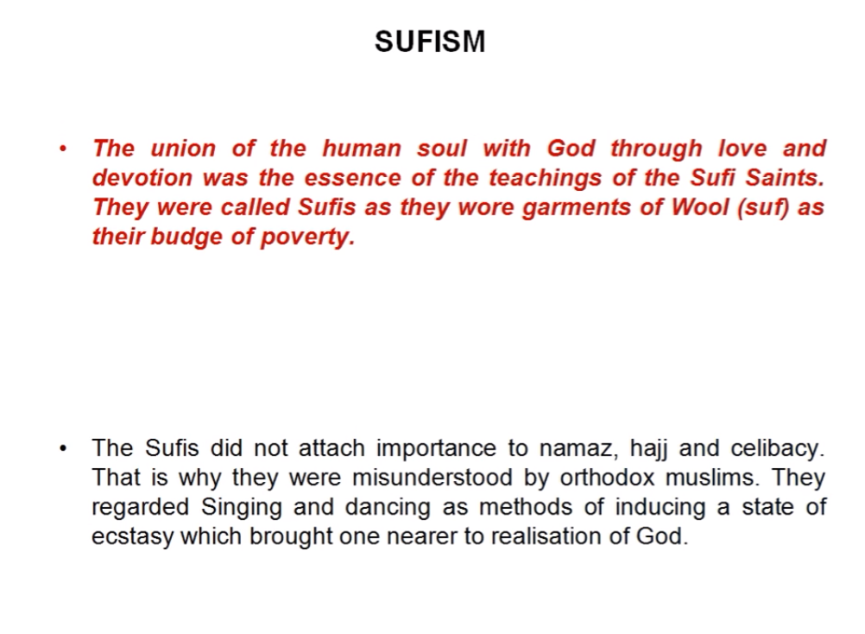

Slide 14
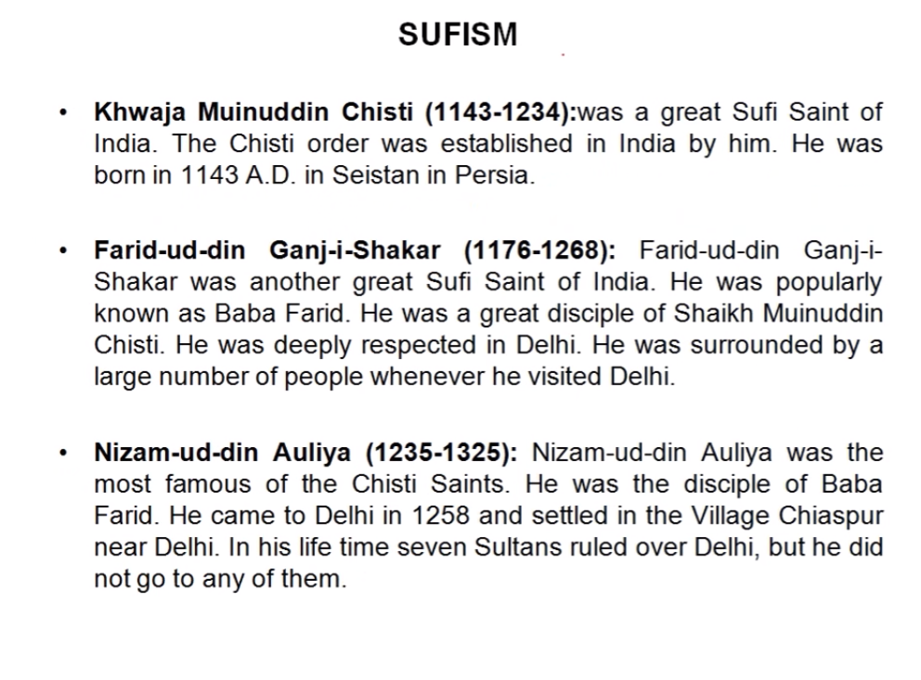

Slide 15


Slide 16
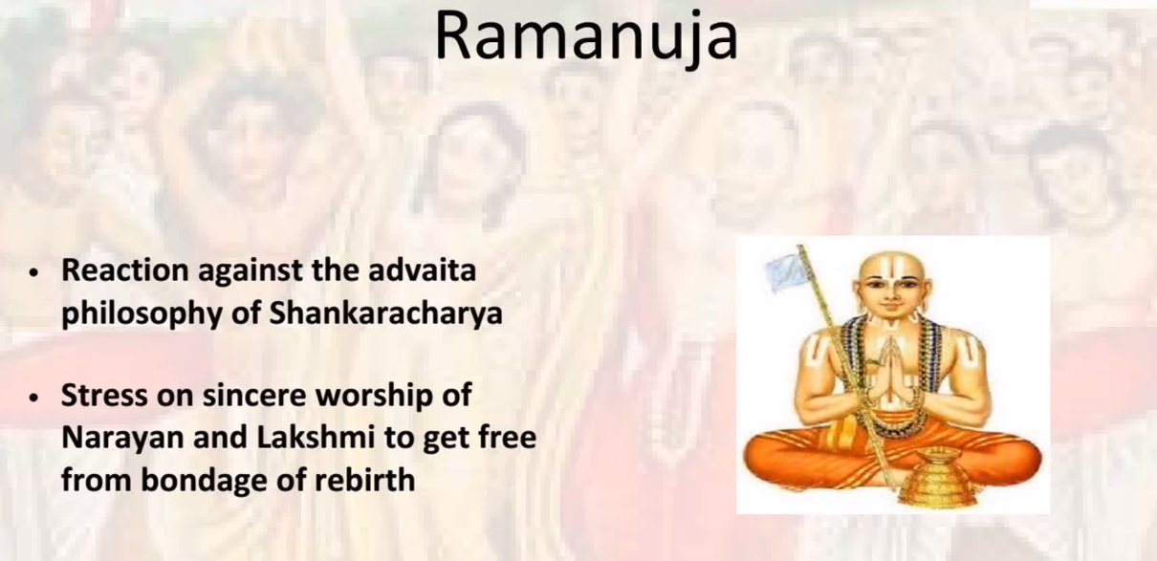

Slide 17
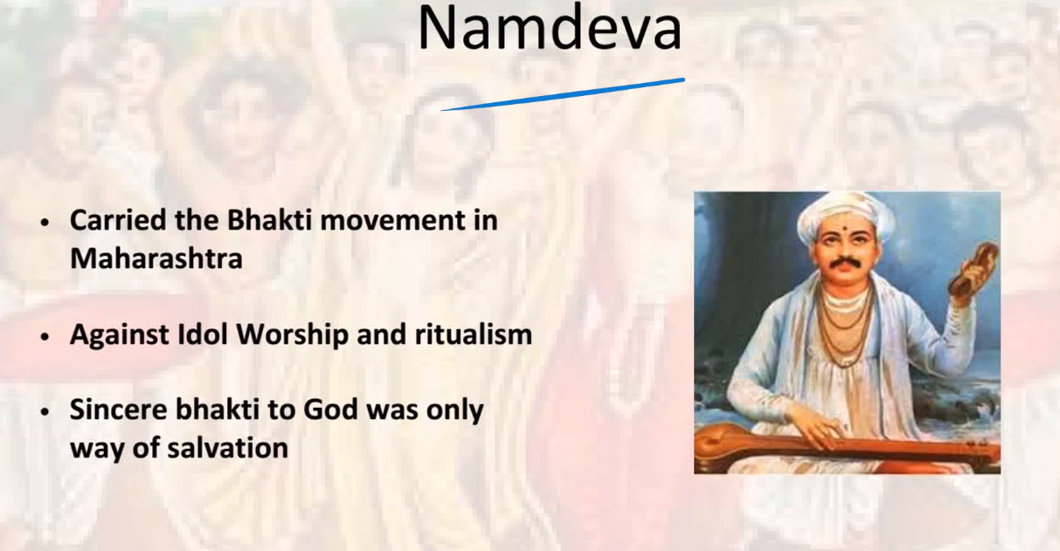

Slide 18
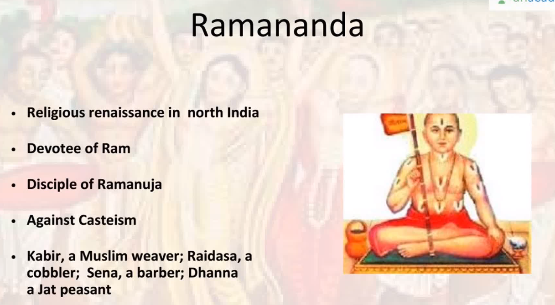

Slide 19
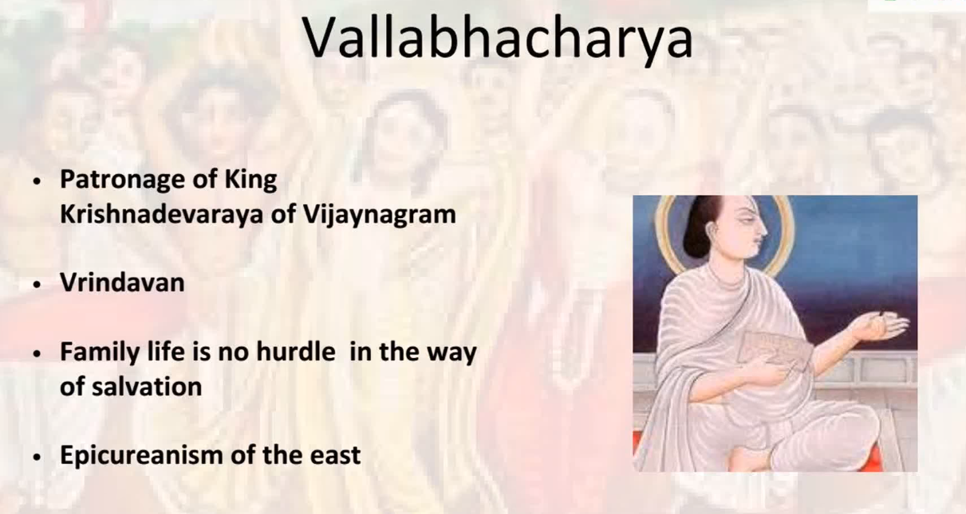

Slide 20
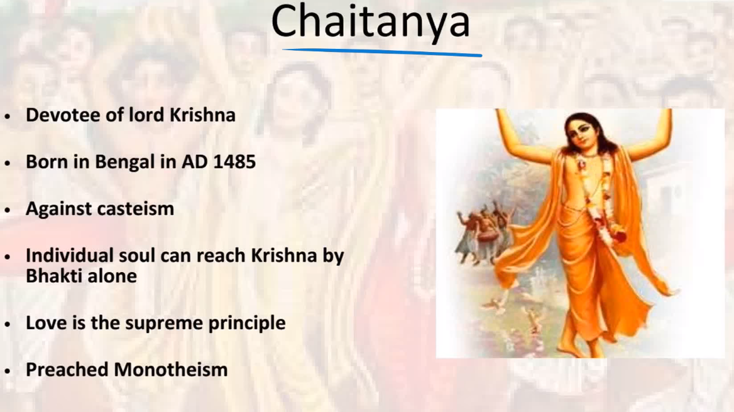

Slide 21
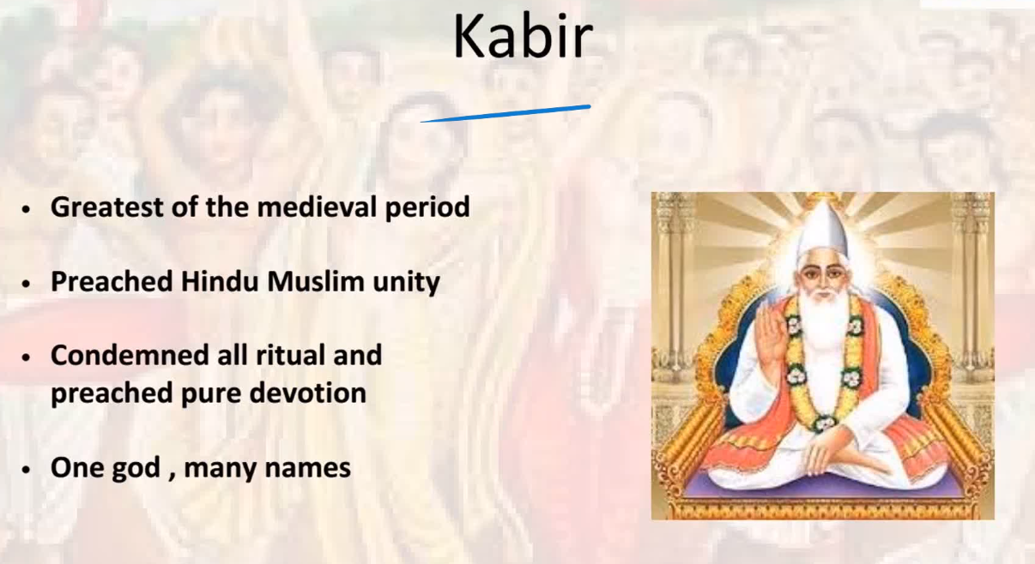

Slide 22
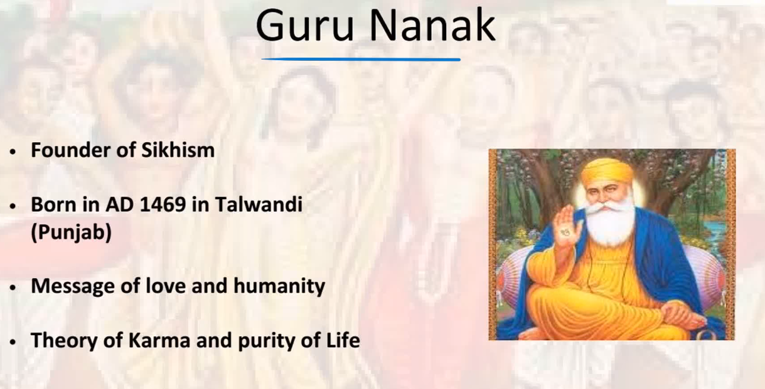

Slide 23
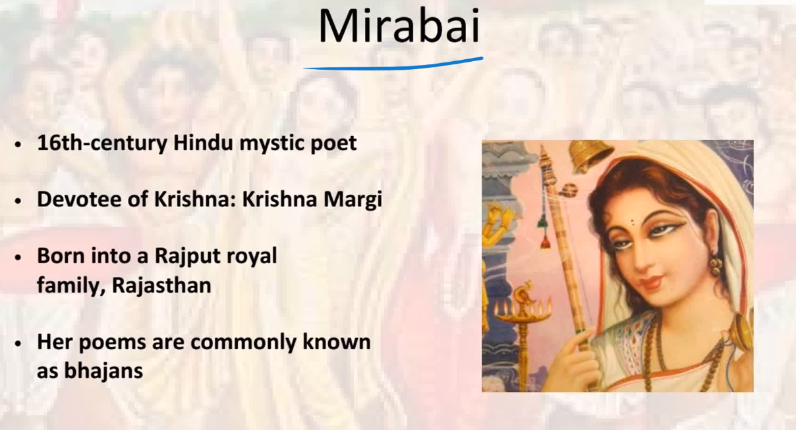

Slide 24
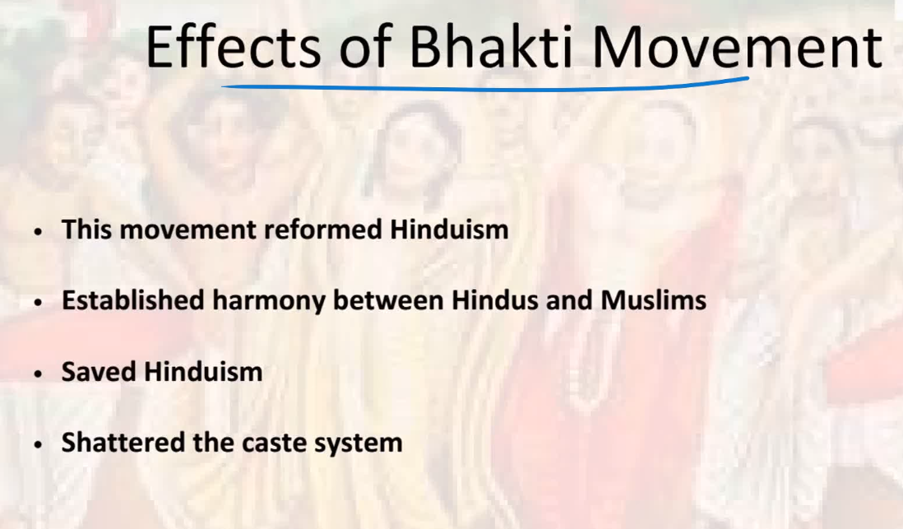

Slide 25
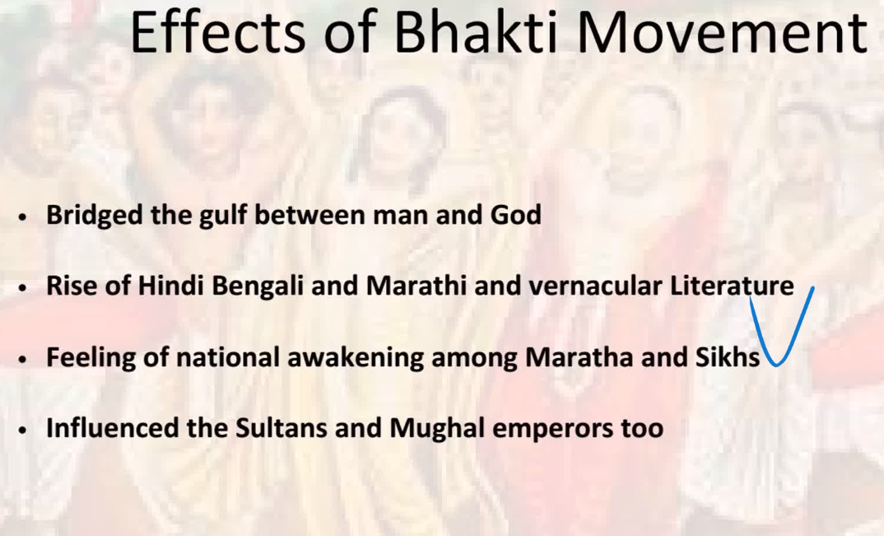

Slide 26
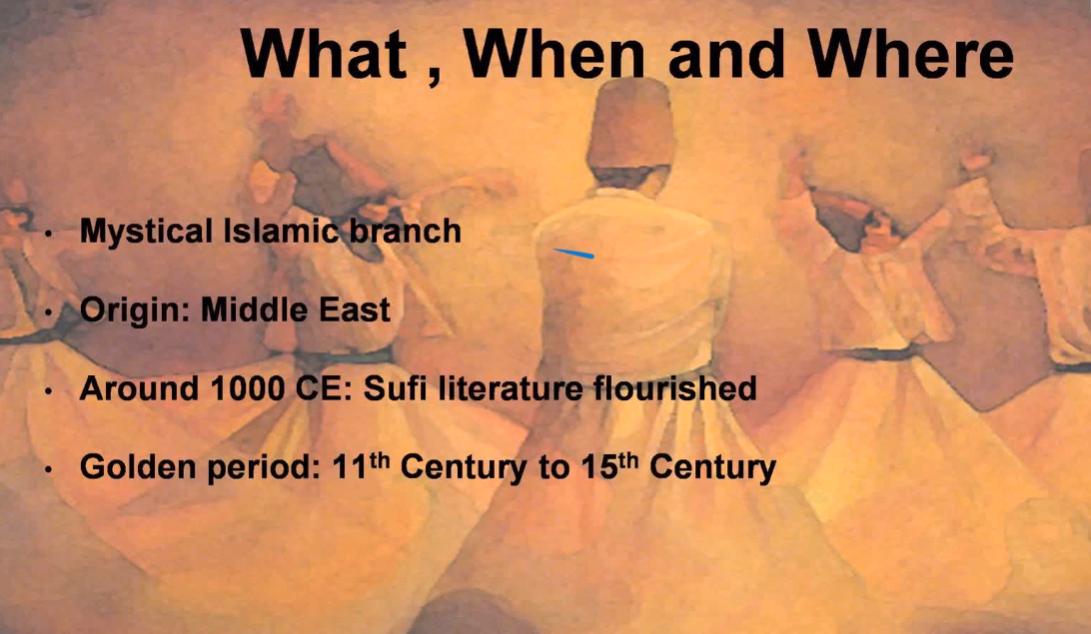

Slide 27
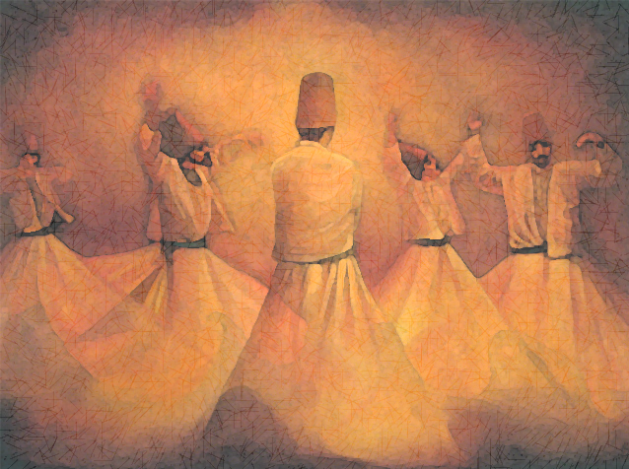
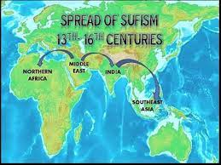
Spread of Sufism

Slide 28
Origin of Sufi
Contemporary of Bhakti movement
Safa in Arabic means Holy
Sufa means wool. After Prophate Mohammad, people who propagated Islam wearing woolen cloths were also called Sufis.
Sophia means knowledge in Greek.

Slide 29
Main Features
12 orders or Silsilas
Monotheistic
Faith in Spiritual Guide – Pir
Self Surrender
Preaching in Arabic, Persian and Urdu
Devotional music and songs.

Slide 30
Sufi Terms
Pir = Saint
Murid = Followers
Khanka = Place where Sufi saints lived
Zikr = Recitation of the name of God
Tauba = Repentance
Fanna = Spiritual merging with the almighty
Urs = Death anniversary of Sufi saint
Sama = Musical gathering
Malfuzat = Collection of the sermons of a Sufi saint

Slide 31
The Ten Stages
Tauba (repentance)
Wara (abstinence)
Zuhd (piety)
Fagr (poverty)
Sabr (patience)
Shukr (gratitude)
Khauf (fear)
Raja (hope)
Tawakkul (contentment)
Raza (submission to divine will)

Slide 32
Why Sufism Flourished
Separated from orthodoxy
Opposed idol worship
Free from rituals
Music
Set an ethical standard
Spoke the language of masses and gave momentum to linguistic unity.

Slide 33
Imparted education
Did not criticize other faiths
No distinction between castes
Great interest in Learning Yoga. Hindu yogis often used to visit the Sufi saints

Slide 34
Sufis in India
Adopted Sama and Raqs (audition and dancing) as a mode of invocation of God.
Sanctioned Majlis –e- Sama
Sama exhilarated their spiritual spirit
Piri Muridi

Slide 35
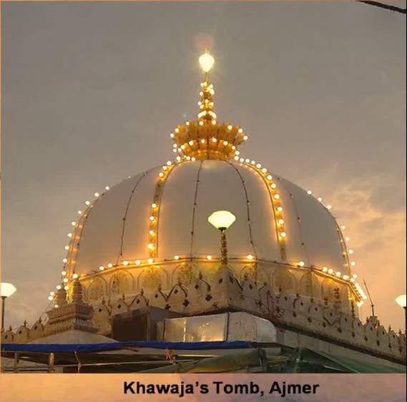
Chisti Silsila
Founder – Khwaja Moinuddin Chisti
Area of influence was North India (Delhi, Ajmer)
Famous saints were Qutubuddin Baktiyar Kaki
Farid Ud Din Ganj Shakar’s verses have been included in Adi Granth of Sikhs. Popularly called Baba Farid.
They kepy away from royal courts
Yogic postures and breath control.

Slide 36
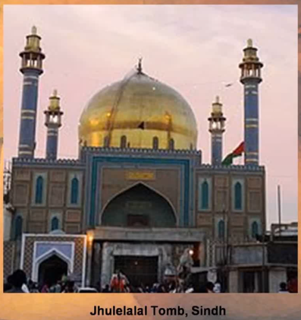
Suharawardis
Founded by Sheikh Shihabuddin Suhrawardi
Area of influence was Punjab, Multan
Famous saints were Rukunuddin Abdulo Fath, Hamiduaddin Nagori.
They accepted Royal Service

Slide 37
Qadris
Founder was Sheikh Nizamat Ullah
Area of influence was Sindh Lahore
Famous saints : Nasiruddin Mohammed Jilani

Slide 38

Naqshbandi
Area of influence was North India
Famous saint was Ubaid Ulla Ahrar
Orthodox sect

Slide 39
Mahadawi
Founder was Mullah Mohammed Mahdi
Area of propagation was Jaunpur
Principle was to oppose orthodox Muslims

Slide 40
Qalandariya
Founder was Abu Wali Qalandar
Famous saints were Sidi Maulah
Wandering monks were called Darveshes

Slide 41
Shattariyya
Founder was Abdul Shattari
Area of propagation – Gujarat, Meerut
Famous saints were Shah Pir
Claimed direct contact with God.

Slide 42
Rishi movement in Kashmir
Nuruddin (Nund Rishi) and his disciples were called Rishis in Kashmir
Rishi Sufi order in Kashmir
Believer in non-violence
Vegetarian

